Slide 1

Towards sustainable energy management : Federated Learning
By
Vatsa Khatri (BT21CSE006)
Prajwal Sam Rachapudy (BT21CSE015)
Harsh Deshmukh (BT21CSE020)
Rashmi Sharma (BT21CSE022)
Under guidance of
Dr. PVN Prashanth

Slide 2
Traditional Energy Management System
The energy sector has relied on CENTRALISED energy management systems.
A central authority oversees the generation, distribution, and consumption of energy.
Examples -
Traditional Grid Systems : Electricity is generated in large power plants (e.g., coal, nuclear, hydroelectric) and distributed to consumers via a network of transmission lines
Third-Party Management : For example, in the U.S., companies like PJM Interconnection manage wholesale electricity markets where they buy electricity from generators and sell it to utilities

Slide 3
Drawbacks of Centralized Models
Single Point of Failure : The centralized nature of these models creates a single point of failure. Any disruption, cyber-attack, or failure at the central control can cause widespread outages.
High Infrastructure Costs : Maintaining centralized grids, involves significant costs, including infrastructure setup, maintenance, and cybersecurity measures.
Lack of Transparency : Consumers in centralized systems often receive a single electricity bill without clear information on the actual costs or sources of energy.

Slide 4
ALTERNATE APPROACHES

Slide 5
1) AI-Assisted Energy Systems
Predictive Energy Management Models : AI and ML to analyze IoT sensor data and predict energy consumption patterns, enabling businesses to optimize their energy use. Eg:- it can predict peak usage hours in an office building and adjust systems accordingly to save energy.
AI-powered device provides detailed real-time statistics of household appliance energy consumption, allowing users to make informed decisions about their energy use.

Slide 6
Limitations of AI-Assisted Systems
Data Privacy Concerns : Centralized AI models require access to large amounts of consumer data. For instance, in smart home systems, sensitive data on daily activities could be exposed to cyber threats.
Dependence on Centralized Infrastructure : AI models often rely on centralized data storage and processing, which may lead to bottlenecks and potential single points of failure.
Cannot handle Heterogenous data.

Slide 7
2) Blockchain-Based Energy Models
Peer-to-Peer (P2P) Energy Trading : Consumers can trade excess energy resources with neighbors using blockchain technology. This decentralized approach eliminates the need for a central authority, making transactions transparent, tamper-proof, and more efficient.
Tamper-Proof Transaction Records : Every energy transaction is recorded on a blockchain ledger, which cannot be altered, ensuring transparency and trust between parties.
Automate Transactions : Smart contracts can be programmed to execute automatically when certain conditions are met. For example, if Bob’s battery level drops below 30%, a smart contract triggers a purchase of energy from Alice.

Slide 8
Issues with Blockchain models
Scalability Issues : As more participants join a blockchain-based energy network, the number of transactions increases, facing issues as transaction times slow down with network congestion.

Slide 9
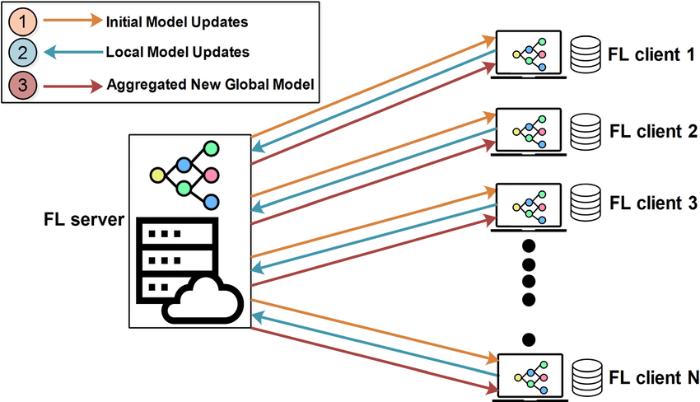
Federated Learning
Federated Learning (FL) is a decentralized machine learning approach where multiple edge devices collaboratively train a model while keeping the data localized.

Slide 10
This is an iterative training process that is coordinated by a central server
The server maintains a global model and sends its current state to the clients at the beginning of each training iteration
the data collected by the individual devices never leaves the device, instead, devices locally update the global model using their local dataset, creating a local model
It has received significant attention in the recent years and has found a variety of applications from keyboard query recommendations to healthcare, from electrical load forecasting to traffic flow prediction

Slide 11
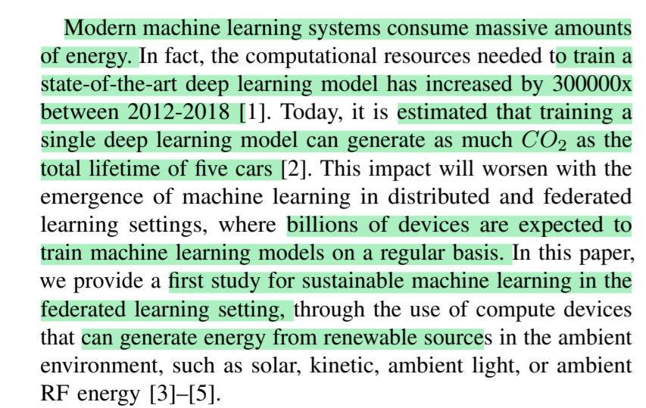
Objective
Attain sustainability in energy management and tackle the issues of data Heterogeneity

Slide 12
Approach
In this approach, we consider devices that are powered by the small quantities of energy generated from the ambient environment, such as solar, kinetic, ambient light or RF energy
Conventional algorithms are designed with the underlying assumption that all clients are available to participate in training if selected.( which may not be the case in Real time)
whether or not a client can participate in training is determined by an underlying energy arrival process, which is intermittent and nonhomogeneous across the clients.
Our goal is to build a scalable and practical federated learning framework
Notes:
Now let us discuss how FL can help us achieve our goal

Slide 13
Assumptions
we consider a federated learning scenario with N clients and a server. Client i holds a local dataset D i . Clients wish to jointly train a machine learning model over the datasets D 1 , . . . , D N .
we assume that clients only have intermittent energy availability, and can participate in the training process only when they have energy available
The energy generation process is not uniform across the devices, that is, some clients may have more frequent energy arrivals than others
How to schedule the clients?

Slide 14
Naive Scheduling algorithms
A naive approach for client scheduling is to schedule clients as soon as they have collected enough energy to participate in training. However, doing so can bias the trained model towards clients with better (more frequent) energy availability
Another approach is to wait until all clients become available for training, and then use a conventional client sampling algorithm. However, waiting for all clients to collect enough energy can significantly increase the total training time needed to achieve a target performance level.

Slide 15
A better Solution
clients participate in training based on their energy profile
It is assumed that a global update occurs at every T time instants, where T is the number of local training iterations that take place between two global updates
Let Ei = # of global rounds taken for a device to generate enough energy to participate in one global round of training
i.e a client will have enough energy to participate in the process at time instants
t , where t mod (Ei T ) = 0
(after every Ei number of rounds, a device generates enough energy to take part
in the training process)

Slide 16
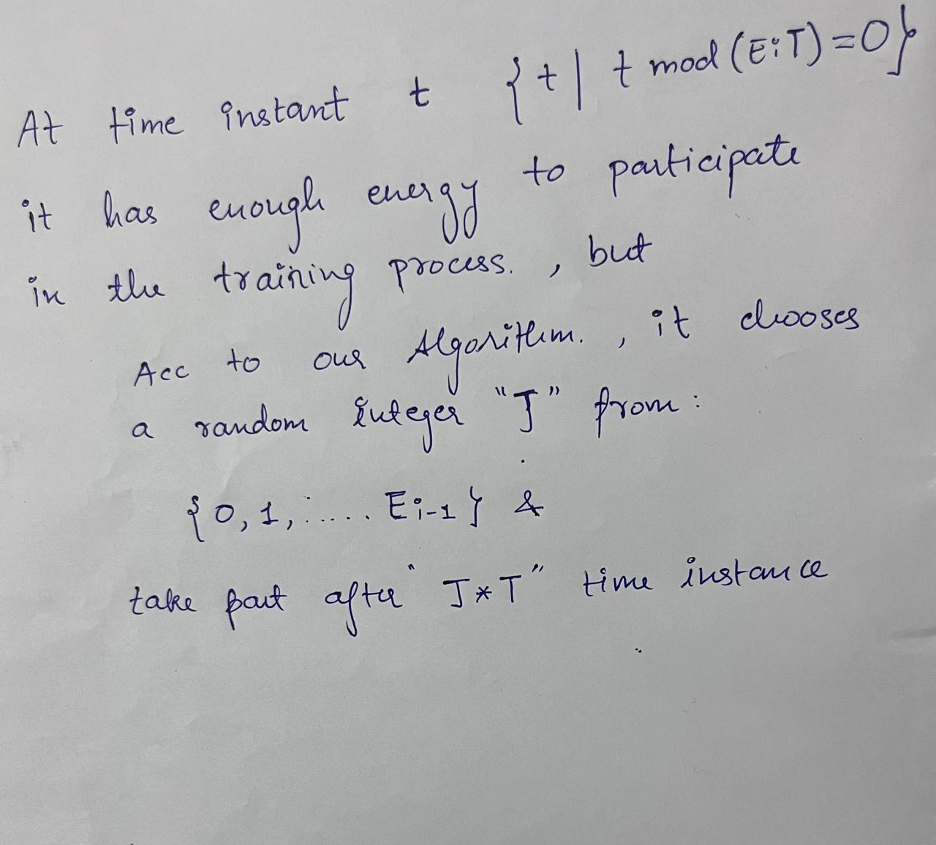

Slide 17
At time instant t {t | t mod (Ei*t) = 0}
The client has generated enough energy to participate in the training process, but instead of participating immediately at “t” instant, The Algorithm states that, it chooses a random integer "J" from:
{0, 1, ... , Ei - 1} & takes part after "J * T" time instances.
i.e at “t+J*T” instant instead of participating at ‘t’ instant.
Because of the randomization ,One particular Client does not always participate at the first opportunity reducing long-term bias.

Slide 18
We use the term global round to refer to the block of T time instances between two consecutive synchronization steps (global updates). In other words, global round t corresponds to the block of time instances t ∈ {t, . . . , t + T − 1}.
First, we note that it takes E i global rounds for client i to harvest enough energy to participate in one global round of training
When t mod (E i T ) = 0, client i samples an integer J uniformly at random from the set {0, . . . , E i − 1}
Then, within the E i global rounds starting at the time instances {t, t + T, . . . , t + (E i − 1)T }, client i only participates during the global round that starts at t + JT , and does not participate in the remaining global rounds

Slide 19
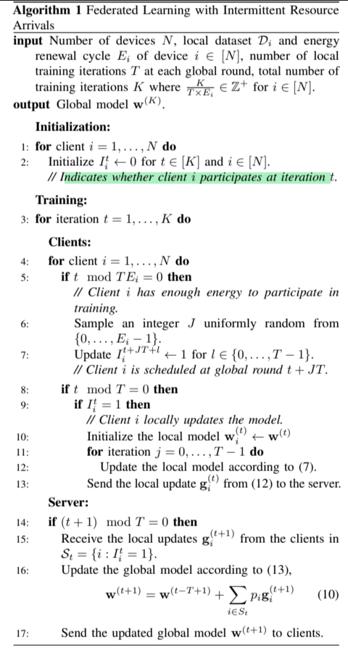

Slide 20
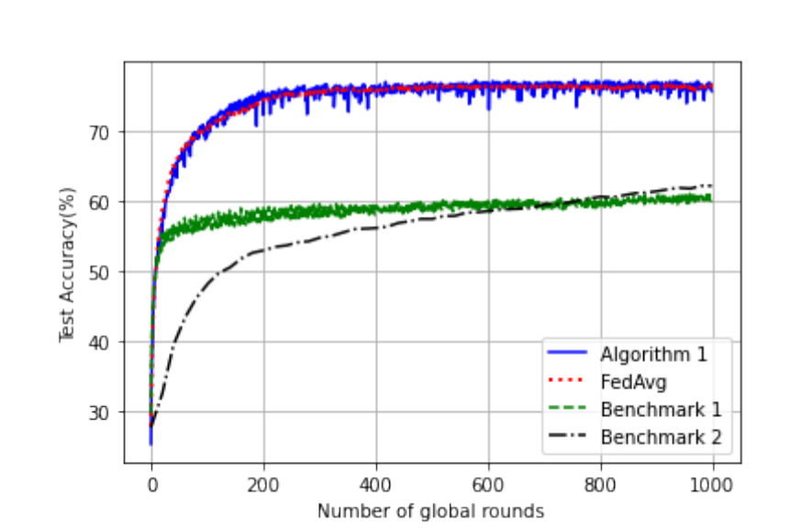
19th International Symposium on Modeling and Optimization in Mobile, Ad hoc, and Wireless Networks (WiOpt)
-A Framework for Sustainable Federated Learning

Slide 21
FL vs ML
Aspect | Federated Learning | Machine learning
Data Privacy | Data remains decentralized on individual devices or local servers | Privacy concerns due to centralized data storage
Communication Overhead | Only model updates are sent to server | Entire data is sent to central server
Security | Privacy concerns due to centralized data storage | Higher risk of data breaches and attacks on centralized data repositories
Datatype | Supports Heterogeneous data | Does not support heterogeneous data, preferred for consistent data

Slide 22
Upcoming tasks
Implement the above-mentioned algorithm using - DAG and Blockchain (and any other algorithm if needed)
- Train the FL model on real time datasets to handle the problem of heterogenous data
- Attaining sustainability and good accuracy

Slide 23
References
19th International Symposium on Modeling and Optimization in Mobile, Ad hoc, and Wireless Networks (WiOpt)-A Framework for Sustainable Federated Learning
12th International Conference on Smart Grid-Federated Learning-Based Energy Forecasting and Trading Platform for Decentralized RenewableEnergy Markets
2022 IEEE IAS Industrial and Commercial Power System Asia-A Review of Federated Learning in Energy Systems
IEEE INTERNET OF THINGS JOURNAL, VOL. 10, NO. 4, 15 FEBRUARY 2023-A Federated Learning and Blockchain-EnabledSustainable Energy Trade at the Edge:A Framework for Industry 4.0

Slide 24
THANK YOU

Slide 25
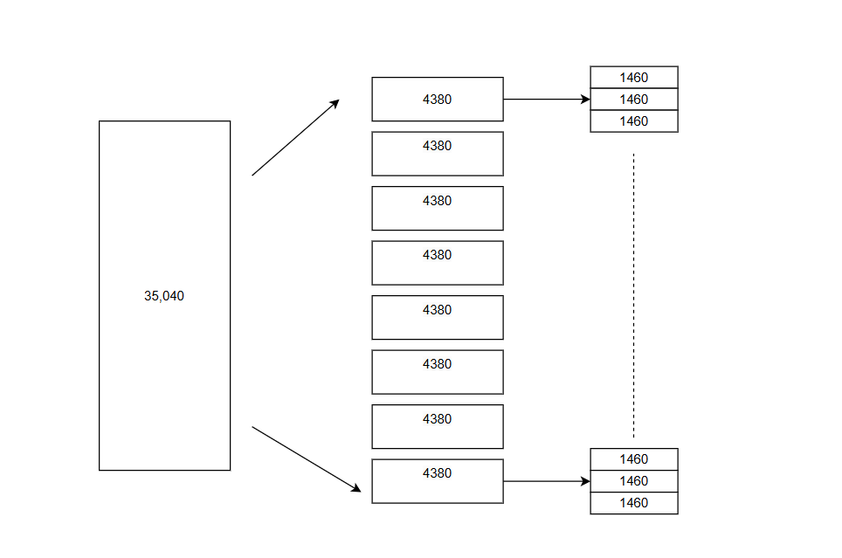
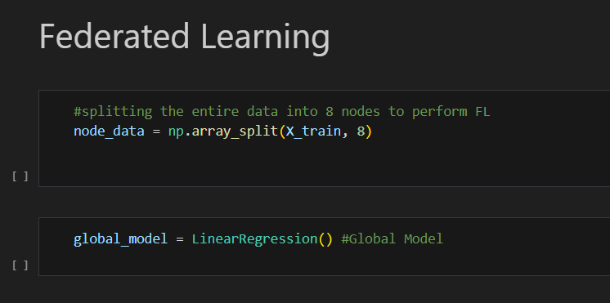
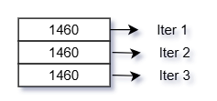
Splitting Data into Nodes

Slide 26
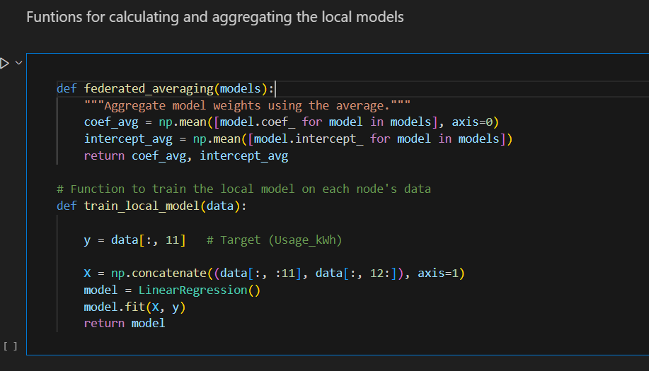
Training and Aggregating Functions

Slide 27
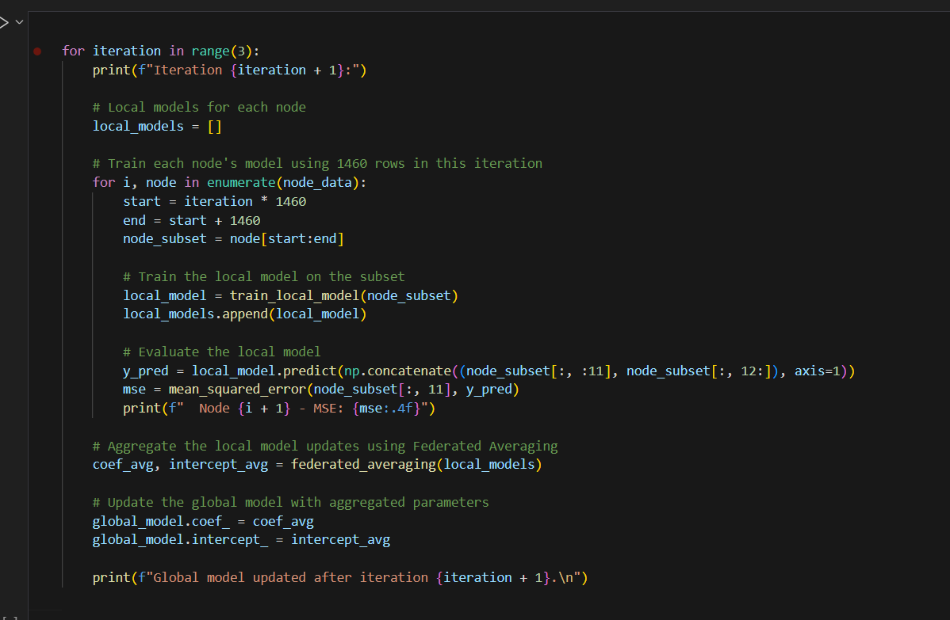
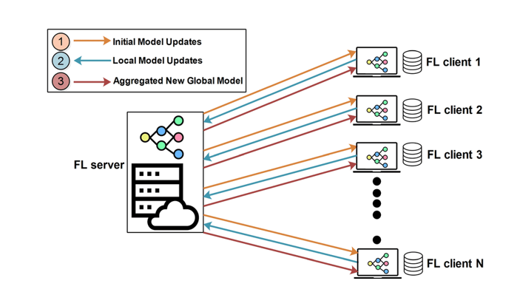
Federated Learning Process

Slide 28
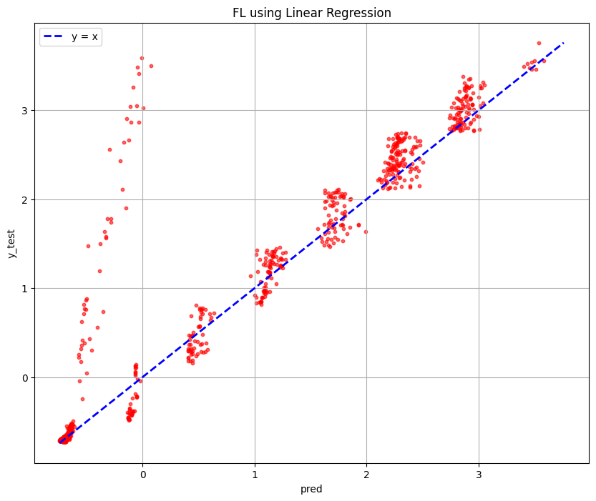
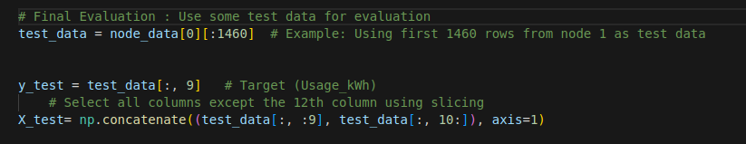
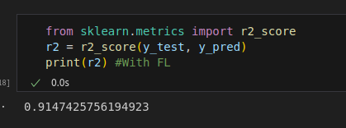
Comparison of Results(FL)

Slide 29
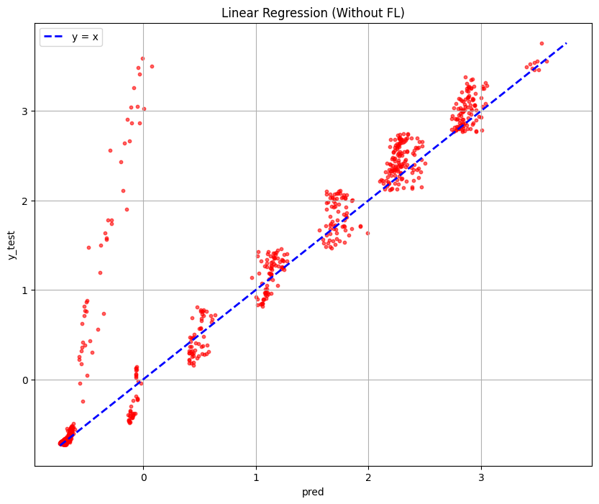
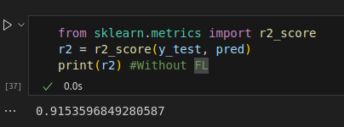
Comparison of Results(ML)

